Slide 1


Knowledge-based WSD Session No.:16 Course Name: Natural Language Processing Natural Language Processing Course Code: R1UC616C Instructor Name: Mr. Amit Yadav Duration: 50 minutes Date of Conduction of Class:

Slide 2

At the end of this session student will be able to t be able to
Describe how Knowledge-Based WSD works and its key techniques (Lesk Algorithm)
Apply a Knowledge-Based WSD algorithm to disambiguate words in a dataset.

Slide 3
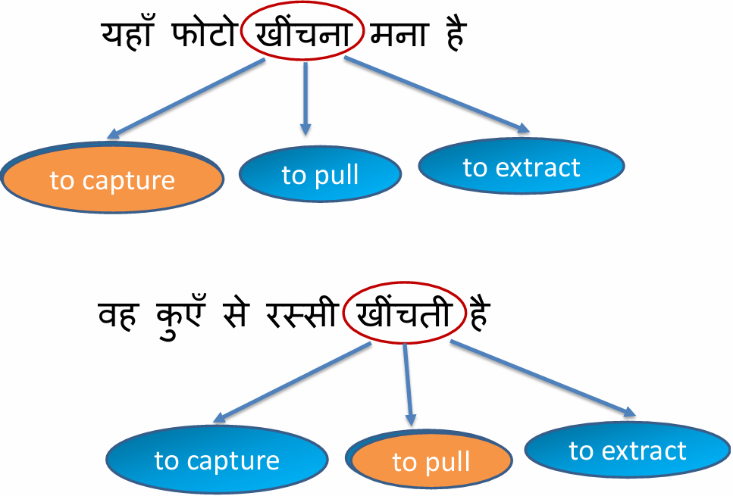
Opening: Ambiguity and Word Sense Disambiguation
Introduction to Ambiguity:
A word, phrase or sentence is ambiguous if it has more than one meaning
Ambiguity in language can lead to misunderstandings, incorrect interpretations, and errors in NLP applications.
Natural languages are ambiguous, so computers cannot understand language like people do.
Word Sense Disambiguation determines a word’s intended meaning, or sense, within a specific context.
WSD is a process to determine the exact sense of the word with respect to the context in which it is used.
https://www.youtube.com/watch?app=desktop&v=wHmONONNxEM

Slide 4


Slide 5
Session Outline
1 Introduction of Ambiguity and Word Sense Disambiguation
2 Activity 1
3 Types of Word Sense Disambiguation
4 Approaches to Sentiment Analysis
5 Activity 2
6 Limitation of WSD

Slide 6
TYPES OF WSD
Knowledge-based WSD(Dictionary Based): :
Knowledge-based approaches based on different knowledge sources such as machine-readable dictionaries or sense inventories, thesauri, etc. Wordnet (Miller 1995) is the most used machine- readable dictionary in this research field. Generally, four main types of knowledge-based methods are used.
LESK Algorithm
Semantic Similarity
Selectional Preferences
Heuristic Method
Supervised WSD:
In this type, sense-annotated corpora are used to train machine learning models. But, a problem that may arise is that such corpora are very tough and time- consuming to create. Some of the s upervised methods are as follows
Decision List
Decision Tree
Naïve Bayes
Neural Networks

Slide 7
Activity 2

Slide 8
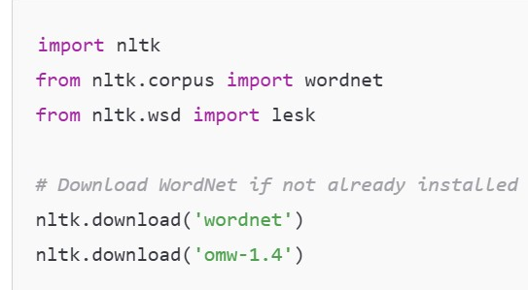
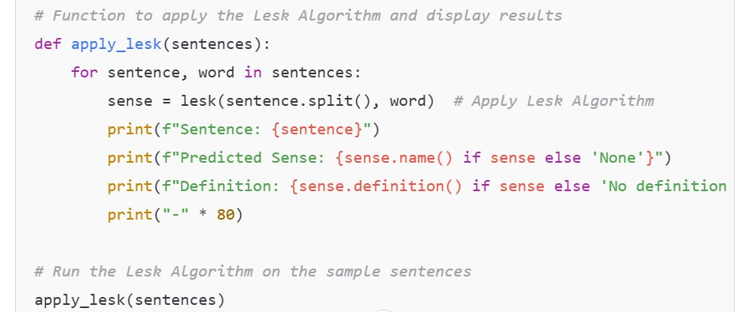
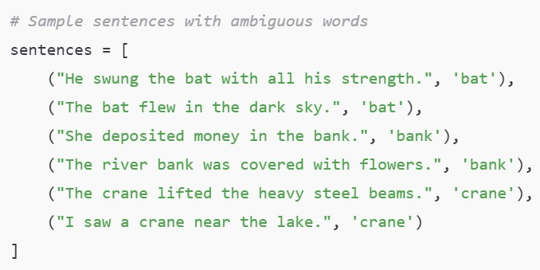
Implementing Lesk Algorithm for WSD)

Slide 9
Limitations
Dependence on Gloss Quality
Exact Word Matching
Sensitivity to Noise
Limited Context Consideration
Computational Efficiency

Slide 10
Summary
This lecture covered how Knowledge-Based WSD works and its key techniques, i.e., the Lesk Algorithm
We have also understood how Lesk Algorithm works by computing definition (gloss) overlap and testing on example sentences to see where Lesk succeeds and fails.
Analyze its limitations, especially for short contexts and low-overlap cases.

Slide 11
Information about the next lesson
Next Lecture: Supervised WSD
https://web.stanford.edu/~jurafsky/slp3/slides/Chapter18.wsd.pdf

Slide 12

Review and Reflection from students

